Slide 1

Stock Price Prediction using Machine Learning
Swastick Ganguly | MY.SC.I5MCA21008​

Slide 2

The best decisions are made by data and evidence, not just gut feelings
Jim Simons

Slide 3
OBJECTIVES
1
2
3
4
5
Develop a predictive model
Boosting the preciseness of the model
Make the model prone to wrong predictions
Comparison
Visualize model predictions against actual stock prices

Slide 4

Introduction
The stock market is known for its high volatility, influenced by various factors such as company earnings, global economic conditions, and investor behavior. Therefore, accurately predicting stock prices remains a complex problem.
The stock market's unpredictable nature requires advanced techniques and tools to capture patterns and trends. Traditional financial analysis relies on historical data and indicators like moving averages, volume, and fundamental analysis. However, machine learning techniques offer a dynamic way to model and learn patterns based on large datasets, making it feasible to achieve more accurate predictions

Slide 5

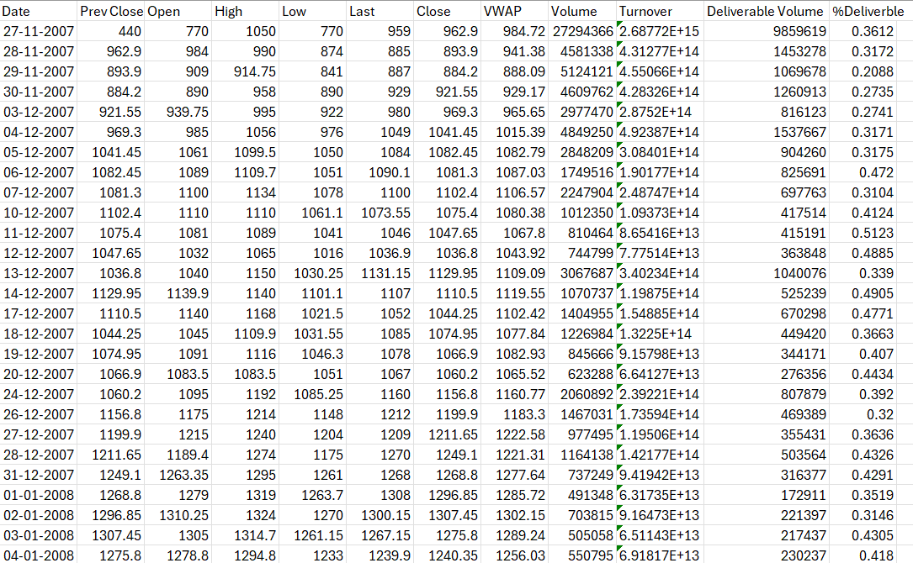

Slide 6
Feature Engineering
Simple Moving Average (SMA): This is the average stock price over a set number of days. It smooths out price fluctuations, helping to show the general trend of the stock.
Exponential Moving Average (EMA): Like SMA but gives more importance to recent prices, making it more responsive to new changes. It’s great for spotting trends faster.
Relative Strength Index (RSI): A momentum indicator that shows if a stock is overbought (above 70) or oversold (below 30), helping identify potential reversal points.
Moving Average Convergence Divergence (MACD): Shows the difference between two EMAs (typically 12-day and 26-day). When it crosses above or below a “signal line,” it suggests potential buy or sell signals.

Slide 7
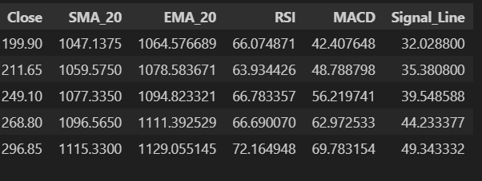
Technical Indicators

Slide 8
PCA
1
Standardize the Data
2
Calculate Covariance Matrix
Principal Component Analysis (PCA) is a dimensionality reduction technique that is widely used in data science, especially when dealing with high-dimensional datasets like stock market data.
3
Compute Eigenvalues and Eigenvectors
4
Rank and Select Components
5
Analyse the data

Slide 9
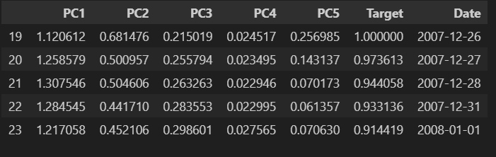
Data After PCA

Slide 10

Window Rolling
Window rolling, also known moving window, is a technique used in time series analysis and machine learning to capture temporal patterns in sequential data. This approach is particularly valuable for stock price prediction, where the goal is to use recent data points to predict future prices.
Why Window Rolling is Used in Stock Prediction
1. Capturing Recent Trends: Financial markets are dynamic, and the most recent data often has the highest predictive value.
2. Addressing Non-Stationarity: Stock prices are typically non-stationary, meaning their statistical properties (like mean and variance) change over time. Rolling windows help address this non-stationarity by using only the most recent data, which is more likely to be consistent over a shorter horizon.

Slide 11
Meet my Models
Support
Vector
Machine
Random Forest Classifier
XG
Boost
Stacking
Different
ML models

Slide 12
Support Vector Machine
SVMs work by finding the optimal hyperplane that separates data into distinct classes, making them suitable for identifying patterns in stock price movements. With techniques like kernel functions, SVM can capture complex relationships in historical stock data, although they may be computationally intensive and require careful tuning to prevent overfitting, especially in volatile markets.
Random Forest Classifier
It operates by creating multiple decision trees during training and averaging their predictions, which reduces overfitting and improves accuracy. This ensemble approach makes Random Forest resilient to noise and useful for capturing intricate patterns in stock price movements.

Slide 13
XG Boost
XGBoost is highly effective in stock price prediction due to its powerful gradient boosting approach, which builds an ensemble of weak prediction models, typically decision trees, by iteratively minimizing errors. It efficiently handles complex patterns and non-linear relationships in financial data, making it suitable for predicting volatile stock prices.
Stacking
Stacking is an ensemble learning technique that combines predictions from multiple models to improve stock price prediction accuracy. In stacking, diverse base models (such as linear regression, decision trees, or gradient boosting) are trained on the same data, and their predictions are then used as inputs to a meta-model, which learns to make the final prediction.

Slide 14
Evaluation Scores​
MSE​
R^2
MAE
Mean Squared Error measures the average squared difference between the predicted and actual values. Lower values indicate better model performance.
Like MAE, MSE ranges from 0 to infinity. A value of 0 means perfect predictions
R-squared (R²) shows how well the model's predictions match the actual data. It tells you the percentage of the data's variation that the model can explain. A higher R² means a better fit.
1 means a perfect fit and 0 indicates the model doesn’t explain any variation beyond the mean of the data
Mean Absolute Error (MAE) is the average of the absolute differences between actual and predicted values.
A value of 0 means perfect predictions, while larger values indicate worse performance.

Slide 15
Results
Evaluation Score | Random Forest | XG Boost | Stacking
Mean Squared Error | 0.00021 | 9.45939 | 0.000014
R^2 Error | 0.99016 | 0.99571 | 0.99516
Mean Absolute Error | 0.00563 | 0.00592 | 0.00460
Evaluation Scores of Model (With PCA)
Evaluation Score | Random Forest | XG Boost | Stacking
Mean Squared Error | 0.00027 | 0.00082 | 0.00074
R^2 Error | 0.99025 | 0.96190 | 0.96571
Mean Absolute Error | 0.01160 | 0.01208 | 0.01160
Evaluation Scores of Model (Without PCA)

Slide 16
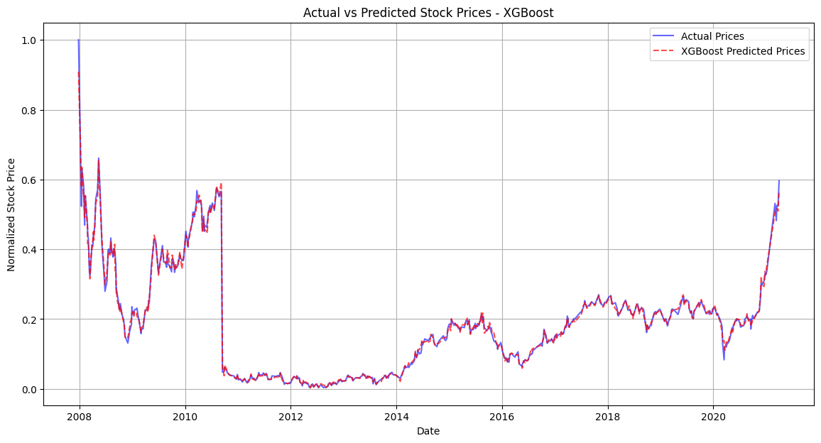
Predictions
Graph for the Predicted Stock Prices of the best Performing Model (With PCA)

Slide 17
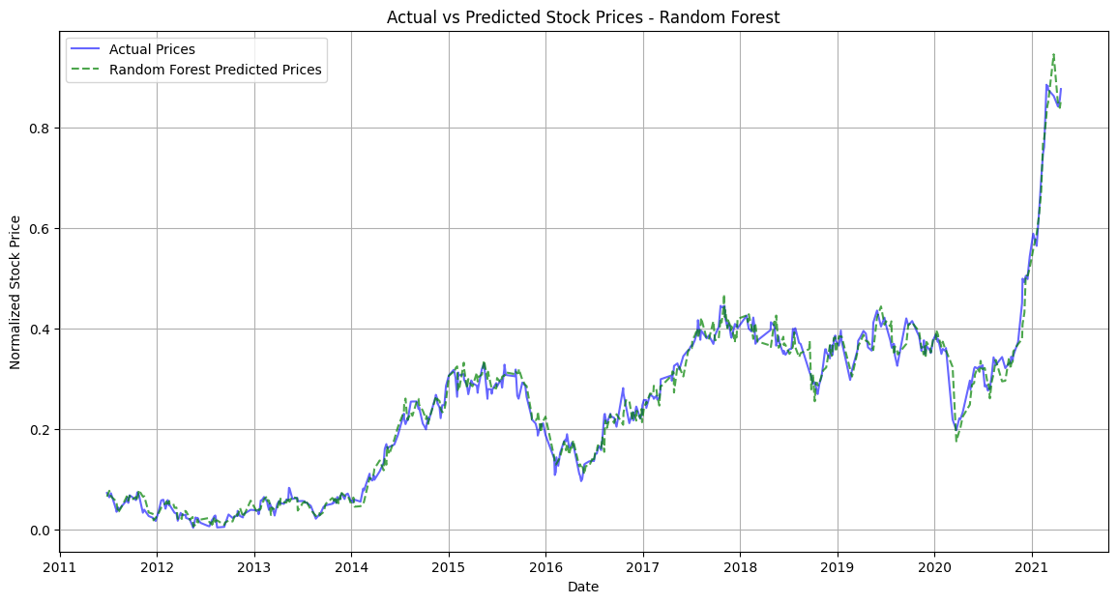
Predictions
Graph for the Predicted Stock Prices of the best Performing Model (Without PCA)

Slide 18

To sum up
In the comparison between models with and without PCA, the results show that applying PCA significantly improves model performance.
PCA enhances the accuracy and reliability of predictions by simplifying feature complexity and capturing key patterns, especially for models like XGBoost and Stacking. Among the three models, XGBoost with PCA emerges as the best performer, with the lowest error metrics and highest R² score, making it the most effective choice for this stock price prediction task.

Slide 19

Thank you
“Never depend on a single source of income, make investment to create a second source”
Warren Buffet

